Slide 1

Artificial Intelligence vs Cybersecurity
Prepared by: Nazmus Sakib
ID: 2102066 Reg: 10193
Date: 30/11/2025

Slide 2

Introduction: Converging Frontiers
Artificial Intelligence (AI)
Cybersecurity
A rapidly expanding domain, enhancing automation, predictive analytics, and decision-making capabilities across industries.
The critical practice of protecting digital systems, networks, and data from an ever-evolving landscape of threats and attacks.

Slide 3








Understanding Artificial Intelligence
AI encapsulates the ability of machines to mimic human intelligence, enabling them to learn, reason, and adapt.
Deep Learning
Machine Learning
Neural networks for complex pattern recognition.
Algorithms that learn from data.
Natural Language Processing (NLP)
Computer Vision
Allowing machines to "see" and interpret images.
Enabling machines to understand human language.
These technologies are leveraged in automation, prediction, and recognition tasks across various applications.

Slide 4

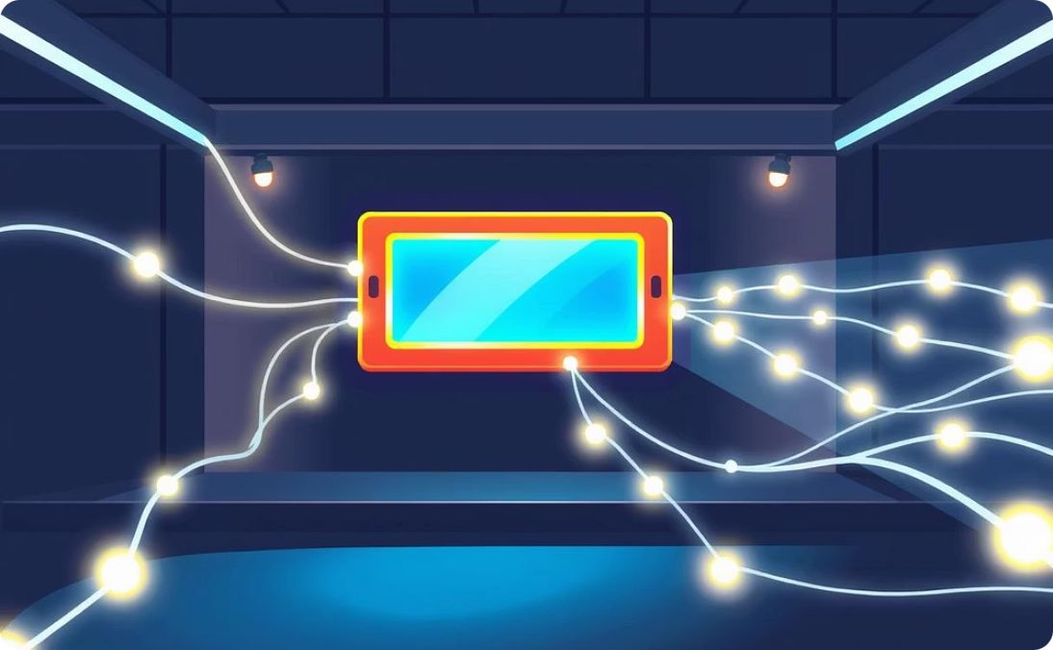

Defining Cybersecurity
Cybersecurity is the essential practice of protecting digital assets from unauthorised access, use, disclosure, disruption, modification, or destruction.
Data Protection
Network Security
Device Security
Safeguarding sensitive information from breaches.
Defending against external and internal threats.
Protecting endpoints like computers and mobile devices.
Key defence mechanisms include encryption, firewalls, intrusion detection systems, and comprehensive risk management strategies.

Slide 5
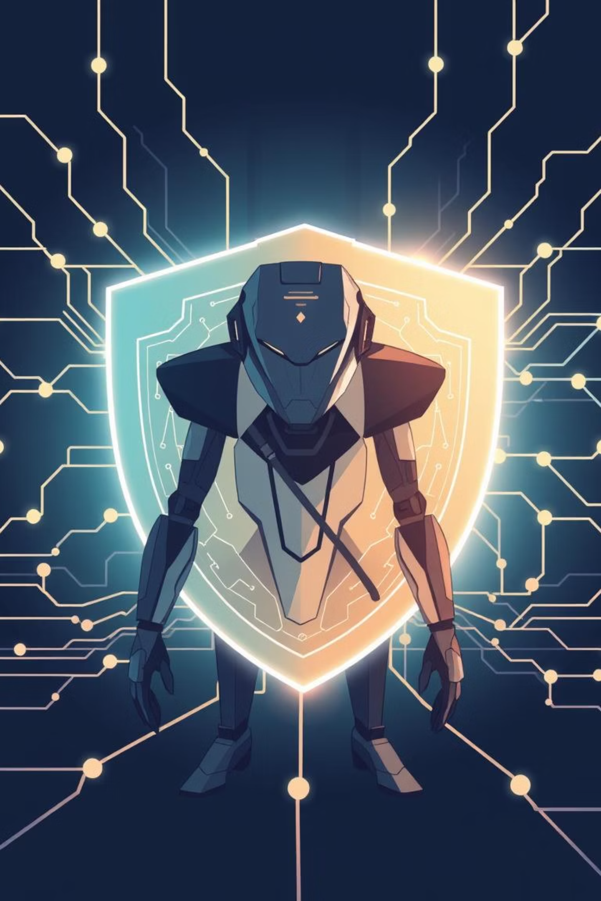




AI as a Cybersecurity Ally
Artificial Intelligence significantly augments cybersecurity capabilities, offering advanced protection against sophisticated threats.
Automated Threat Detection
AI algorithms can automatically identify and flag malicious activities in real-time.
Behavioural Anomaly Detection
Machine Learning identifies unusual patterns that indicate potential cyber-attacks.
Faster Incident Response
AI can automate responses to attacks, drastically reducing reaction times.
Predictive Attack Forecasting
Utilising big data analysis, AI predicts future attack vectors and vulnerabilities.

Slide 6
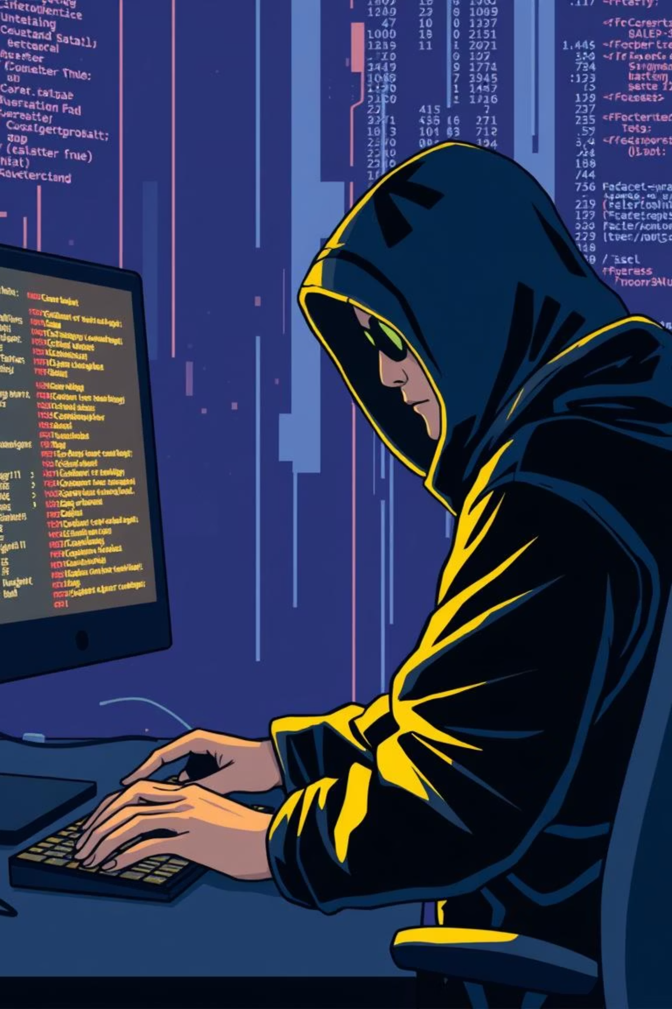




Cybersecurity Risks Posed by AI
While AI offers powerful defence mechanisms, it also introduces new vulnerabilities and tools for malicious actors.
AI-Powered Malware
Malware becomes more adaptive and evasive, learning to bypass traditional defences.
Accelerated Password Cracking
AI algorithms can crack complex passwords at unprecedented speeds.
Sophisticated Phishing
AI generates highly convincing and personalised phishing emails, increasing success rates.
Automated Cybercrime
AI enables attackers to launch highly automated and rapid cyber-attacks, scaling malicious activities.

Slide 7
AI vs. Cybersecurity: A Comparative View
Understanding the distinct yet intertwined roles of AI and Cybersecurity is crucial.
Purpose
Automate intelligence and decision-making
Protect digital systems and data
Strength
Fast, predictive analysis, automation
Defensive strategies, prevention, risk mitigation
Weakness
Potential for bias, errors, and ethical misuse
Limited by human expertise, reaction time
Key Risk
Misapplication, autonomous weapons, privacy concerns
Emergence of new, AI-driven threats

Slide 8




Integrating AI into Cybersecurity Tools
AI is rapidly being integrated into various cybersecurity tools to enhance their effectiveness and proactive capabilities.
SIEM with AI
AI-Powered Firewalls
Security Information and Event Management (SIEM) systems leverage AI for advanced threat correlation and anomaly detection.
These next-generation firewalls use AI to intelligently adapt to new threats and filter malicious traffic.
Fraud Detection
Biometric Access Control
AI models analyse transaction patterns to instantly detect and prevent fraudulent activities.
Face recognition and other biometric AI enhance physical and digital access security, offering robust authentication.

Slide 9

The Future Landscape of AI & Cybersecurity
The interplay between AI and cybersecurity will deepen, shaping the future of digital defence.
AI as Core Defence
1
AI will transition from a supplementary tool to an indispensable component of cybersecurity strategies.
Increased Automation
2
Cybersecurity operations will become increasingly automated to counter the speed of AI-driven attacks.
Ethical & Safe AI
3
Emphasis will be placed on developing AI ethically and ensuring its safe deployment to prevent misuse.
Talent Demand Surge
4
There will be a significant increase in demand for professionals skilled in both AI and cybersecurity.

Slide 10

Conclusion: A Symbiotic Relationship
Artificial Intelligence and Cybersecurity are inextricably linked, each profoundly influencing the other.
Deep Interconnection
AI and cybersecurity are not separate entities but deeply intertwined, forming a symbiotic relationship.
Enhanced Security
AI significantly strengthens defensive capabilities against a myriad of cyber threats.
New Risks Emerge
The advent of AI also introduces novel vulnerabilities and sophisticated attack vectors.
Balanced Development
Achieving a secure digital future hinges on ethical AI development and balanced technological advancement.

Slide 11
Thank
You

